Slide 1
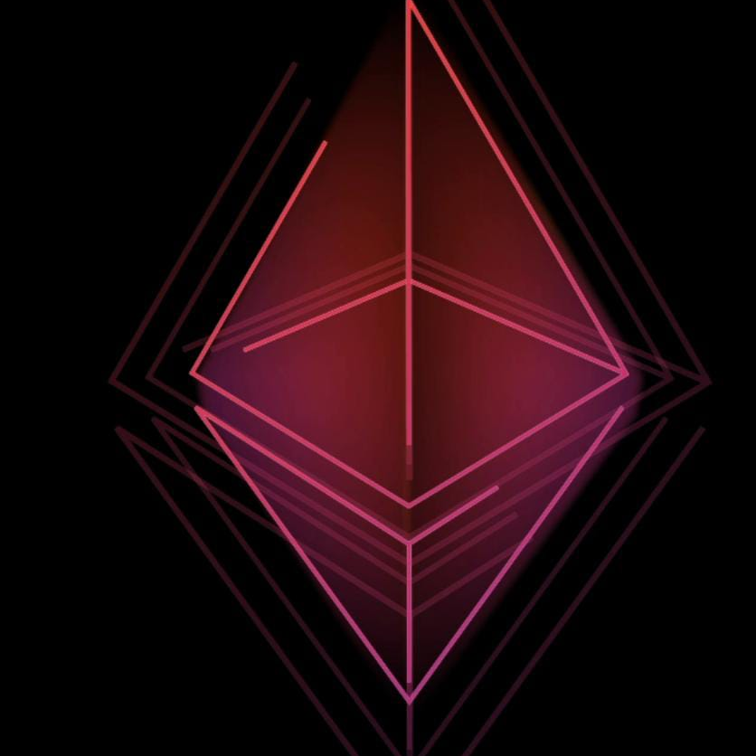
Team Paradox 2.0 FC:40

Slide 2
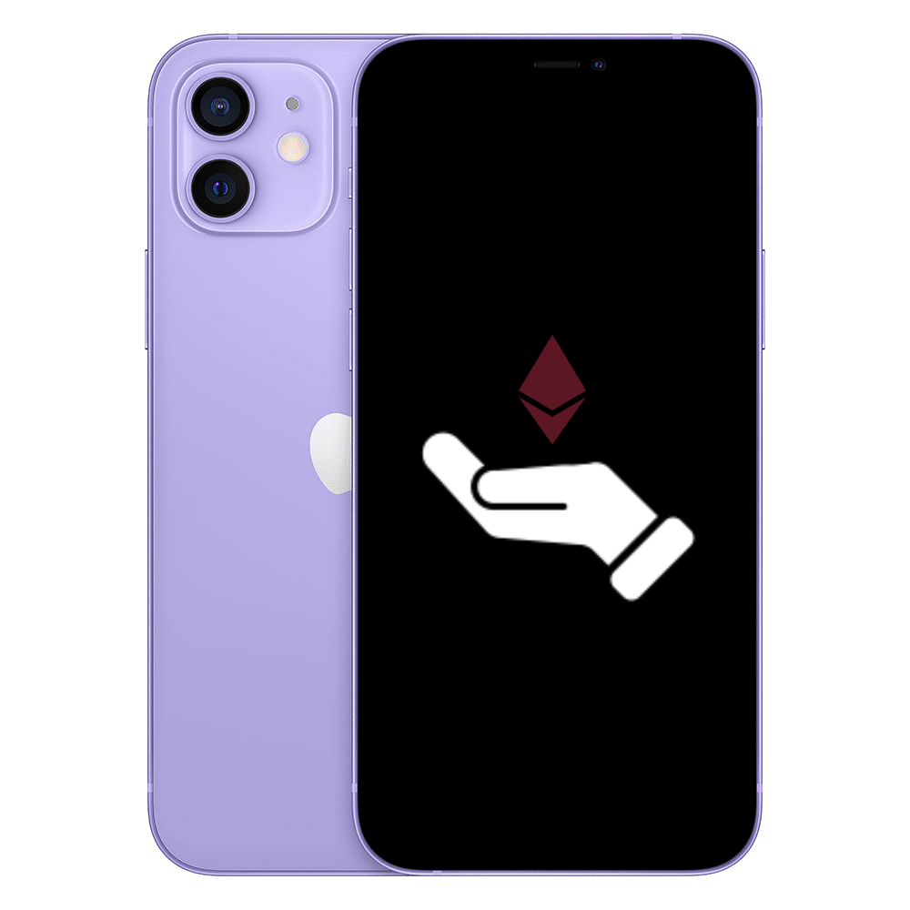
Coalesce
Funding through blockchain
Potential to
”democratize innovation”
and
“reshape entrepreneurship”
In India

Slide 3
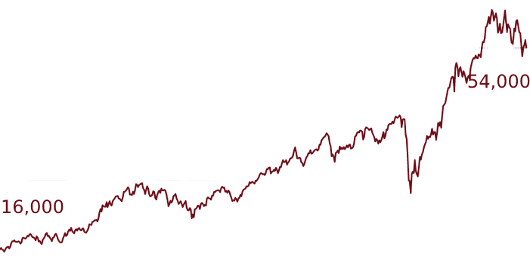

Why
The BSE index has seen huge growth in last ten years , right now at 54,000 points from 16000 points.
In the last year only 14.3 million new investor has been added.
India is home to 100 unicorn with a total valuation of 332.7 bn dollar .
Even with this tremendous growth many revolutionary start-up find it hard to receive funding , even if the company’s product is new and innovative , solving a real-world problem and loved my people, the lack of capital leads to failing of start-up
With all the angel investor and Venture capitalist receive huge equity and board member ship of the company.
Lack of Long-Term Thinking with Venture capitalist
The most stressful and potentially detrimental aspect of seeking venture funds is the sacrifice made in ownership and decision making.
We often see people donating money , to new innovative product because they liked the product and don’t wish for anything in return , and just want to support the creator. Just like on Kickstarter ( Pebble time watch receive 20 million dollar in donation )
So is there was a way in which company can crowdfund money in term of receiving funding.

Slide 4
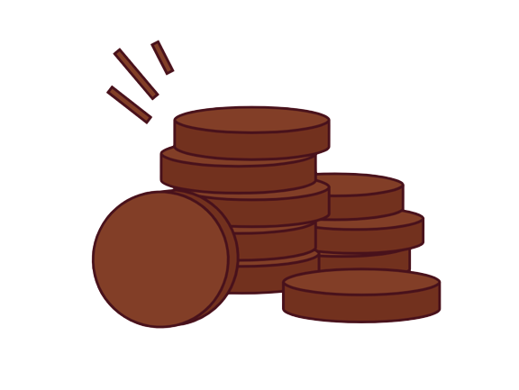
ICO
INITIAL COIN OFFERING

Slide 5
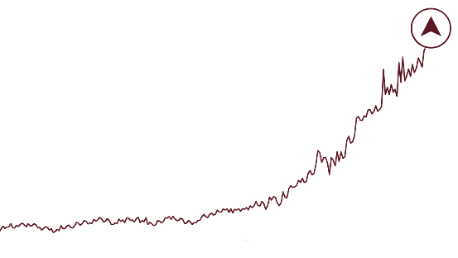
An initial coin offering (ICO) is the cryptocurrency industry's equivalent to an initial public offering (IPO). A company seeking to raise money to fund a service or product can launch an ICO as a way to raise funds. Interested investors can buy into an initial coin offering to receive a new cryptocurrency token issued by the company. This token can represent a stake in the company or project or can be used as a utility coin for future use in that platform. But this token will not ensure any authority of investor in the company , the founder or initial investor will have all the authority in the company.
Alongside structuring the ICO, the crypto project usually creates a white paper, which it makes available to potential investors via a new website dedicated to the token. The promoters of the project use their white paper to explain important information related to the ICO.
A white paper is an informational document usually issued by a company to promote or highlight the features of a solution, product, or service that it offers or plans to offer. White papers are also used as a method of presenting government policies and legislation and gauging public reaction.
Whenever a crowd sale takes place, the company gets liquid capital in the form of Ether that was paid by the investors, as well as holding onto a reserved amount of the ERC-20 tokens that were sold in the crowd sale
Drivezy raised 15mn from ICO funding .
Ethereum raised money from ICO , initially the ether token were at $0.31 to $3128.

Slide 6
Our App: COALESCE
Provide a platform for companies to apply for ICOs , by filling forms and providing white paper regarding product and company.
Once we receive a application , we can test it through our benchmark requirements.
If it passed it will be termed as approved , and our automated system will create tokens/coins for the company.
The company will receive tokens/coins in their MetaMask wallet , our app will also provide a interface for the company to sell these coins to early investor/etc.
We would also provide interface (our website) to advertise tokens along with their whitepaper or website , to attract future investor.
Once the company‘s tokens receive enough user in their network they can apply for listing in public exchange portal.

Slide 7
Extensions :
Our app is not limited to start-ups , its support can be extended to various field as given in these example :
Entertainment industry : Token can be generated to fund movies , investor can look through detail of movie and choose to invest ,the token can be used to avail tickets or will receive profit amount after the movie is released.
Farming : Companies can set up ICOs to raise fund to set machinery and buy raw materials. After the season token value will receive profit of the season. The farming industry is massive in India providing 57% of total workforce is engaged in this field.
Real State : Developer can raise fund through ICOs to set up future projects. This industry in India has a total net worth of $9.30 billion. The entertainment industry is growing day by day , with movie industry only having 183 billion Indian rupees net worth in total
These project will work as underlying property on top which tokens value will depend , after reaching enough user in the network , one can list these topic on public exchange.

Slide 8

Business Model
Growth of crypto in India :
The biggest Indian crypto broking platform, Coin Switch Kuber, registered a 3,500% rise in transaction volumes and touched 14 million users recently.
Leading cryptocurrency exchange, Wazir, witnessed record trading volume of over $43 billion in 2021 – the highest in India – a growth of 1,735% from 2020.
Even after so many government regulation , crypto is still growing hard in India
We want to tap this Market because we can see its scope, with every ICOs we generate we going to receive a basic pay amount and some percentage of tokens of product.
Because we are taking tokens as fees, we will only generate tokens for those company who we believe in to have successful future.

Slide 9
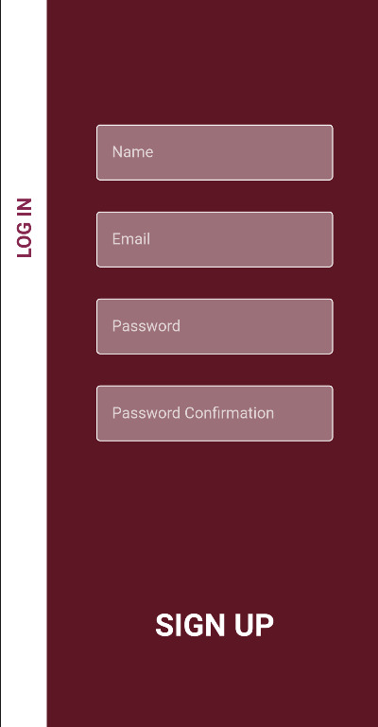
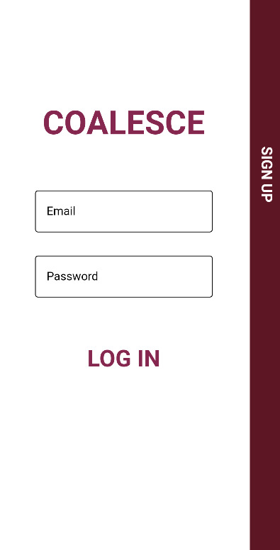
Sign up and Login Page

Slide 10
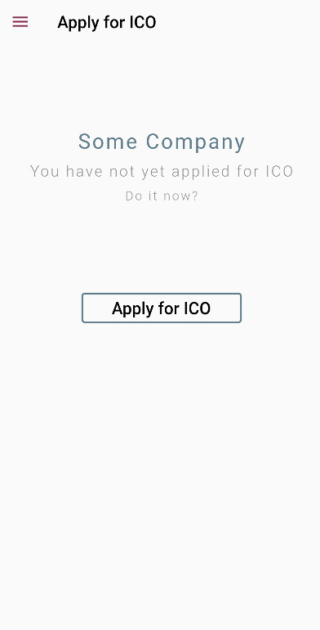
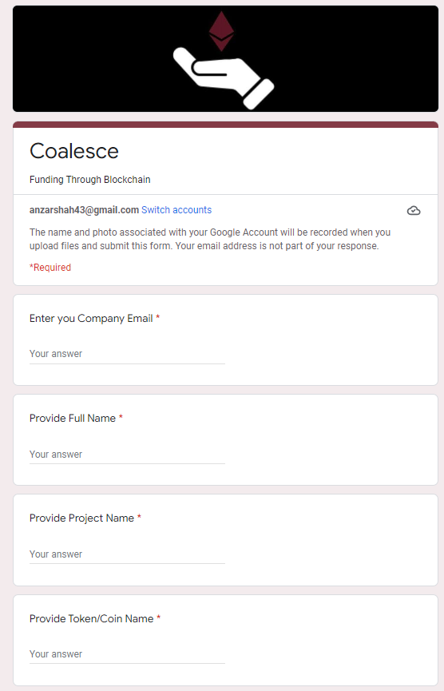

Apply for ICO / Check status of Application

Slide 11
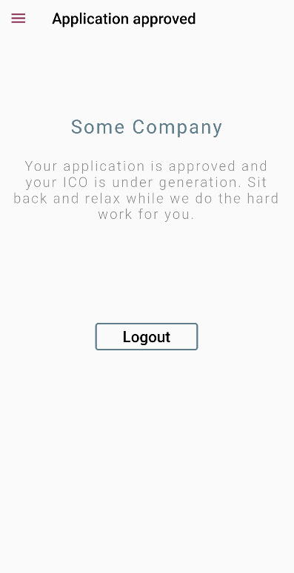
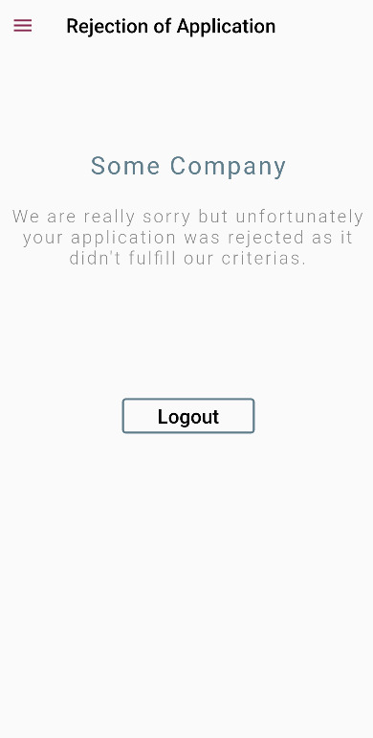
Approval check

Slide 12
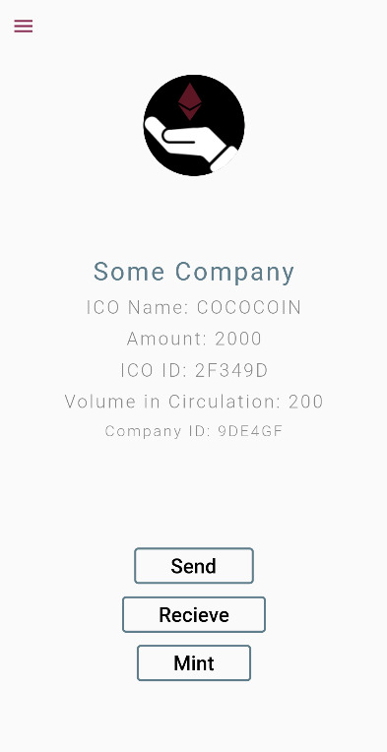
ICO detail after Creation

Slide 13
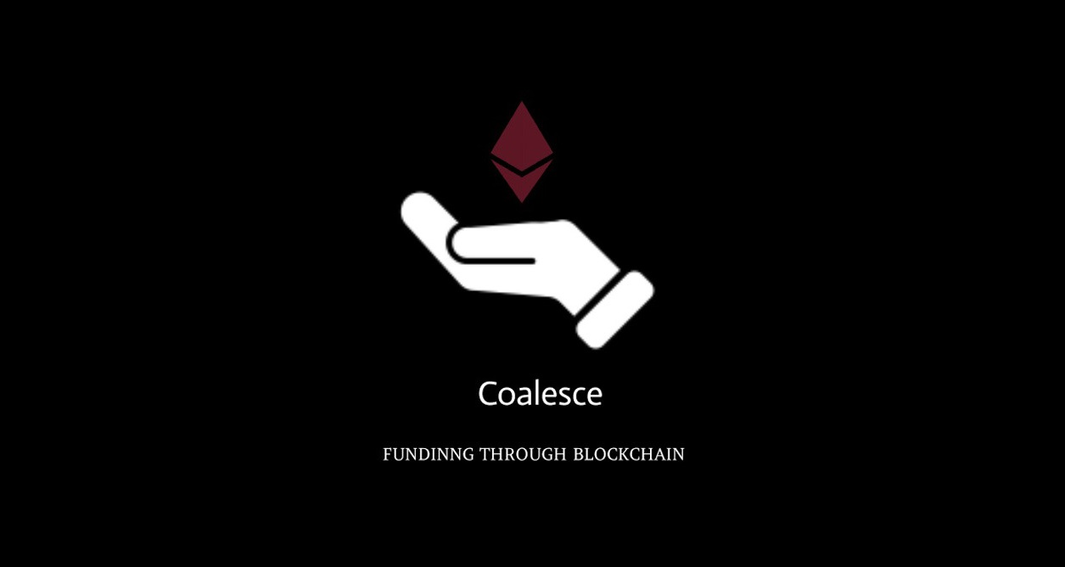
THANK YOU …
Anzar Shah
Prabhat Joshi
Dinanshu Bishwas

